Slide 1

Python Scripting with Network
Day 5

Slide 2

Agenda
Python for Network Automation
ISO/OSI Layer
OSI & TCP/IP Mapping
Python libraries for Networking
Python Modules
Python Type Errors
Python Lambda Function

Slide 3
Python for Network Automation
Python has become the industry-standard language for network automation because it allows engineers to manage complex, multi-vendor infrastructures with code instead of manual command-line interface (CLI) entries.
It enables faster deployments, reduces human error, and facilitates "Infrastructure as Code" (IaC) initiatives

Slide 4
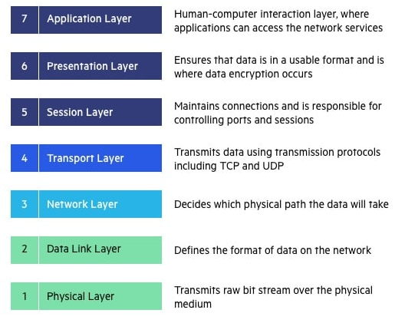
ISO/OSI Layers of Networking
The Open Systems Interconnection (OSI) model describes seven layers that computer systems use to communicate over a network.
The OSI model is divided into seven distinct layers, each with specific responsibilities, ranging from physical hardware connections to high-level application interactions.

Slide 5
OSI Layer – Real World Example
When a user in New York sends an email to a colleague in London, the process starts at the Application Layer (Layer 7). The user’s email client, such as Outlook, uses SMTP (Simple Mail Transfer Protocol) to handle the email message.
The email is then passed to the Presentation Layer (Layer 6), where it is formatted and encrypted to ensure proper transmission.
Next, the email moves to the Session Layer (Layer 5), where a session is established between the sender’s email server in New York and the receiver’s email server in London. This layer manages the session, keeping the connection open long enough to send the email.
The email data then reaches the Transport Layer (Layer 4), where it is divided into smaller packets. TCP ensures these packets are sent reliably and in the correct order.
At the Network Layer (Layer 3), each packet is assigned source and destination IP addresses, allowing it to be routed through multiple networks, including routers and switches, to reach the recipient in London.
The Data Link Layer (Layer 2) then uses MAC addresses to handle the packets’ journey across local networks and correcting any errors that occur.
Finally, the Physical Layer (Layer 1) converts the data into electrical signals, which are transmitted over fiber-optic cables under the Atlantic Ocean.

Slide 6
OSI Layer - Advantages
The Physical Layer converts the signals back into data packets, which are reassembled at the Data Link Layer.
The Network Layer ensures the packets have arrived correctly, and the Transport Layer reorders them if necessary.
The Session Layer maintains the session until the email is fully received.
The Presentation Layer decrypts and formats the email, and the Application Layer delivers the email to the client, where it appears in their inbox.
Determine the required hardware and software to build their network.
Understand and communicate the process followed by components communicating across a network.
Perform troubleshooting, by identifying which network layer is causing an issue and focusing efforts on that layer.

Slide 7
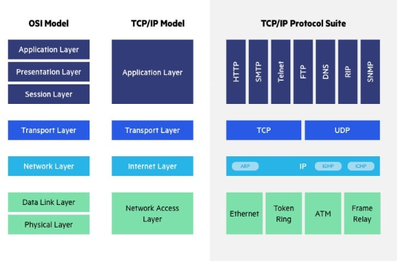
OSI Layer v/s TCP/IP Model
The Transfer Control Protocol/Internet Protocol (TCP/IP) is older than the OSI model and was created by the US Department of Defense (DoD). A key difference between the models is that TCP/IP is simpler, collapsing several OSI layers into one:
OSI layers 5, 6, 7 are combined into one Application Layer in TCP/IP
OSI layers 1, 2 are combined into one Network Access Layer in TCP/IP – however TCP/IP does not take responsibility for sequencing and acknowledgement functions, leaving these to the underlying transport layer.

Slide 8
Python Libraries for Networking
Netmiko: A multi-vendor library based on Paramiko that simplifies SSH connections to network devices like Cisco, Juniper, and Arista.
NAPALM: A vendor-agnostic abstraction layer that provides a unified API for managing diverse network environments.
Nornir: A pluggable multi-threaded framework written in Python that allows you to manage network device inventory
and execute tasks at scale.
ncclient: A Python library specifically for automating devices using the NETCONF protocol.
Jinja2: A templating engine used to generate configuration files dynamically based on device variables.
TextFSM/TTP: Tools used to parse unstructured CLI output into structured data formats like JSON
Ansible - Ansible is an open-source, agentless orchestration framework used to configure, provision, and manage network devices
such as routers, switches, and firewalls at scale. For network engineers,
it serves as a highly accessible entry point into infrastructure-as-code because it uses simple, human-readable
YAML syntax rather than complex programming languages

Slide 9
Python Modules
In Python, a module is simply a file with a .py extension that contains code—like functions, variables, and classes—that you can use in other programs. Using modules helps you organize large projects into smaller, reusable pieces.
Modules are three types – Built-in modules, External Modules and user- defined modules.
Built-in Modules: These come pre-installed with the Python Standard Library. Examples include math for calculations, random for generating numbers, and datetime for handling dates.
External (Third-Party) Modules: These are created by the community and can be installed via the Python Package Index (PyPI) using a tool like pip. Popular ones include NumPy for data science and Requests for web browsing.
User-Defined Modules: Any Python file you create (e.g., mymodule.py) can be imported into another script as a module

Slide 10
Python Type Errors
A TypeError in Python occurs when an operation or function is applied to an object of an inappropriate type. For example, you will trigger this error if you try to add a string and an integer together (\("5" + 2\)).
Incompatible Operations: Performing math on mixed data types (e.g., subtracting a string from an integer).
Calling Non-callables: Attempting to use a variable like a function (e.g., my_string()).
Invalid Indexing: Using a non-integer (like a string or float) as an index for a list or tuple.
Non-iterable Objects: Trying to loop over a single value like an integer or float.
Wrong Function Arguments: Passing data to a function that expects a different type, such as passing a list to a function expecting a number

Slide 11
Python Lambda Functions
A lambda function in Python is a small, anonymous function that can have any number of arguments but can only contain one expression. Unlike standard functions defined with the def keyword, lambdas do not require a name and are typically used for short-lived operations.
lambda keyword: Signals the start of an anonymous function.
Arguments: The input values (can be zero, one, or many).
Expression: A single line of code that is executed and its result is automatically returned

Slide 12
Wrap Up
Python Automation for Network engineering
Python Network Libraries
Python Modules
Python Lambda Functions

